Slide 1

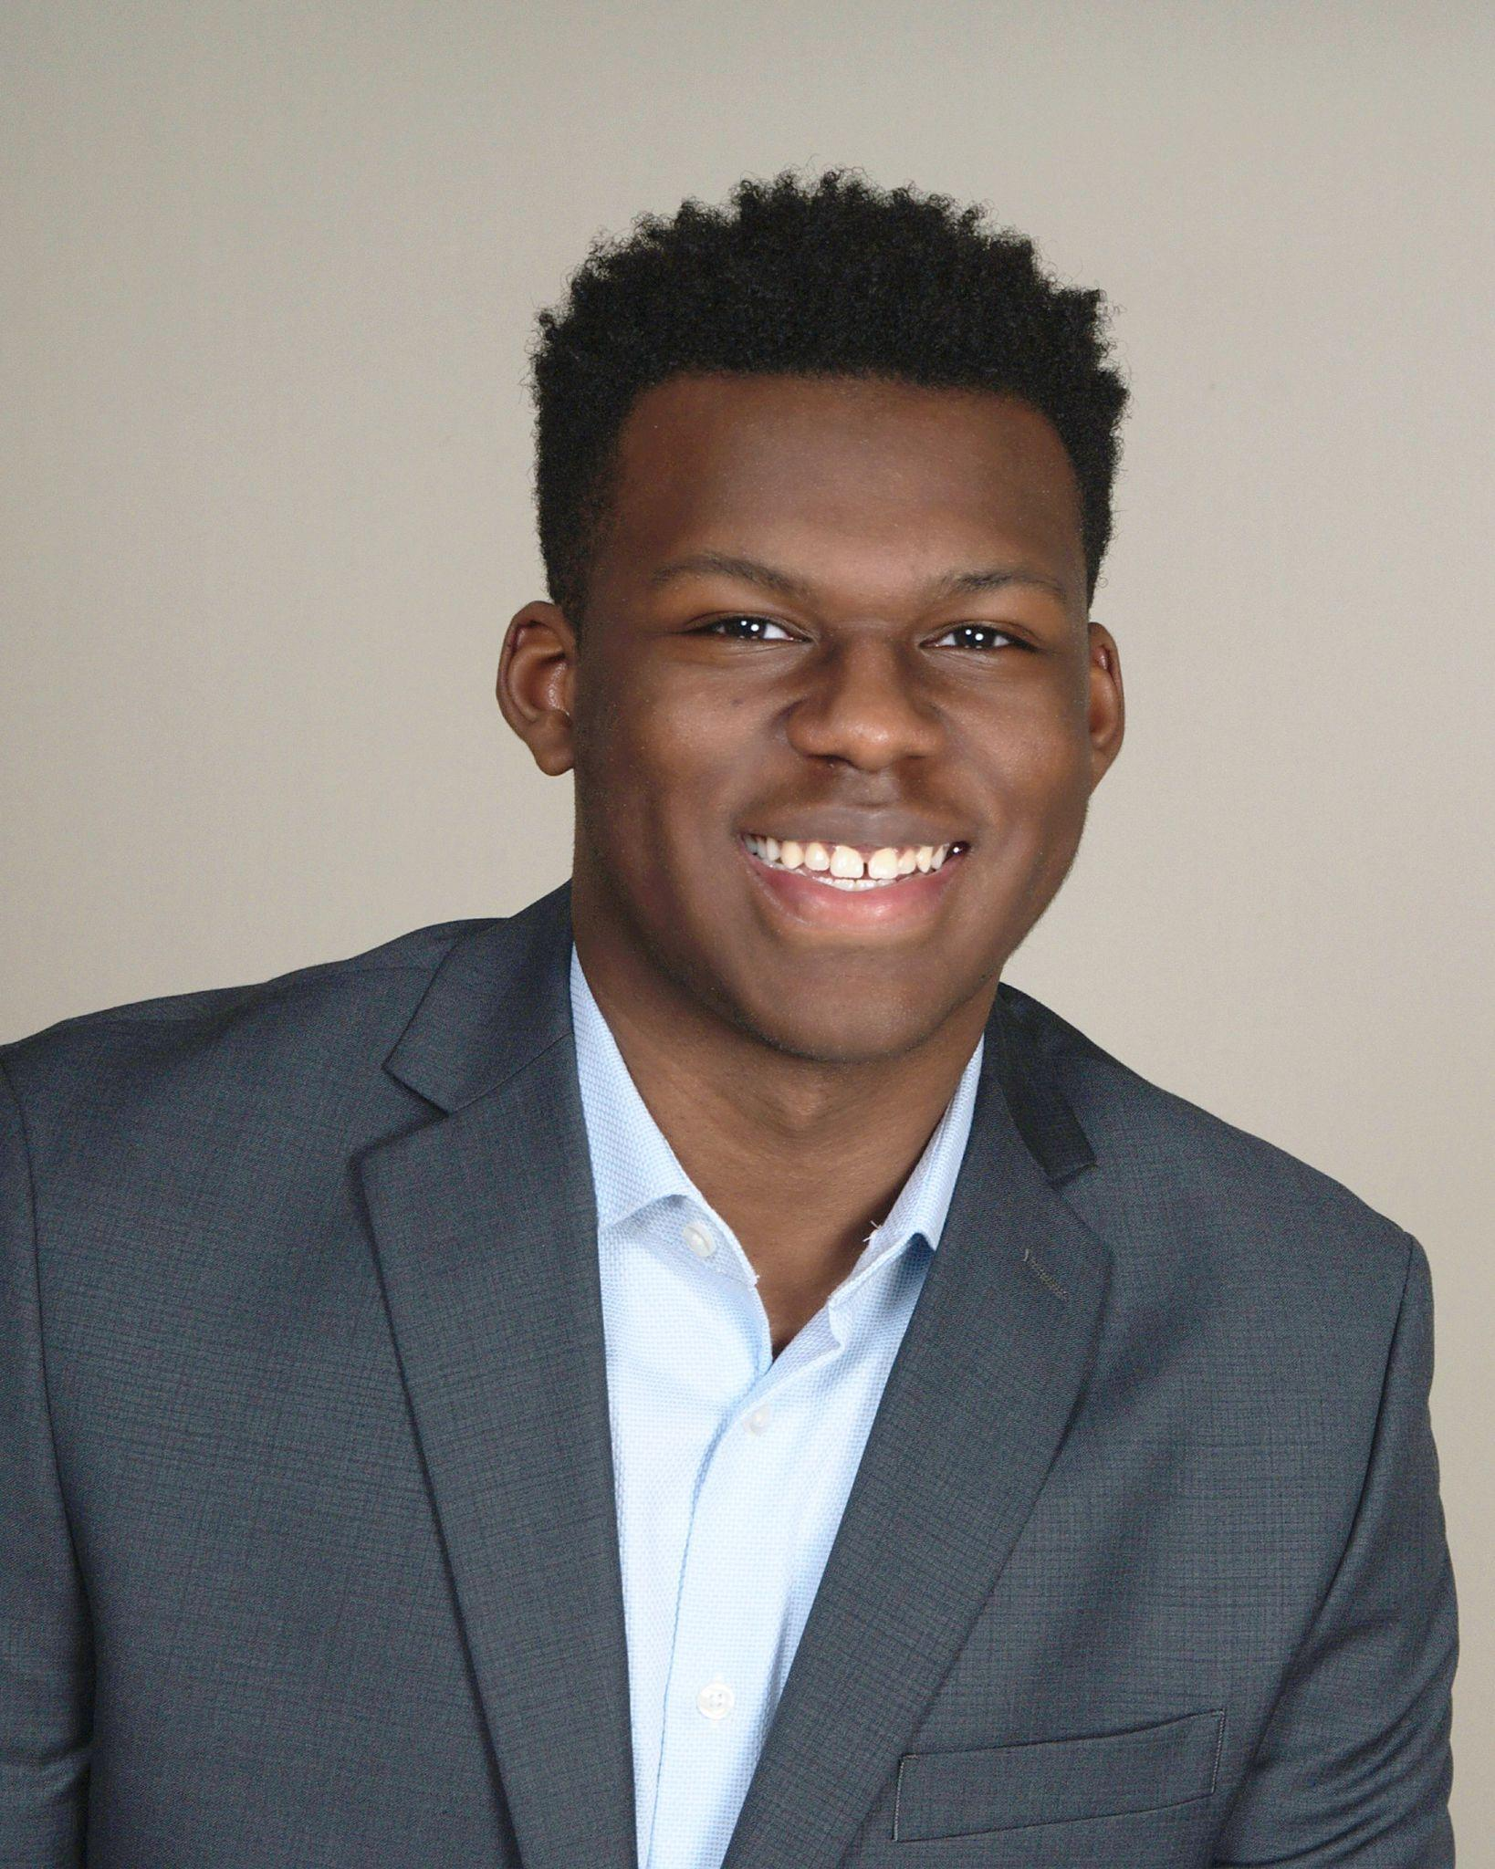
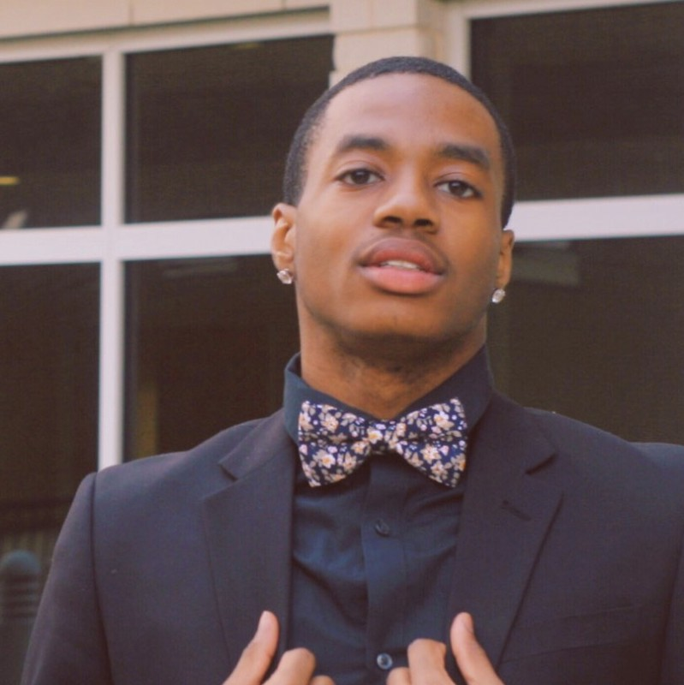
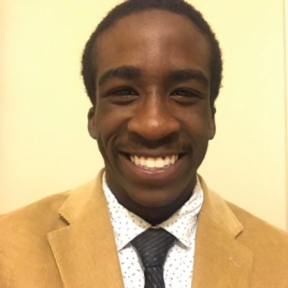
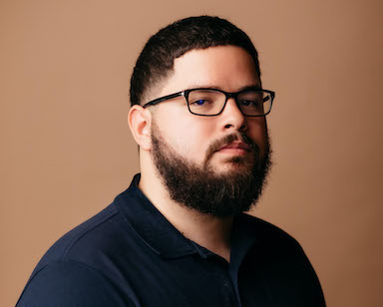
Rams Hack 2021
Team Name: Suit Technology
Donovan Benson Kel Lee Abdul Mohammed Hector Santiago
Topic Idea: Our plan is to make a chatbot that provides useful information to the user like scholarships, and work study/ internship opportunities.

Slide 2
Progress Report
We have a working html page for the front end of our chat bot that we named suitbot.
We have also created conversation flows for suitbot.
Our next steps are to work on the conversation training for suitbot and connect him to the html page.

Slide 3
Our Idea
A lot of valuable information about scholarships, work studies and other opportunities can be sometimes hard to discover as a result of us moving to more virtual learning and not being in the same classroom with some of the professors that have these opportunities.
That inspired us to create a chat bot that could help students stay connected to these opportunities and provide easy access to learn more about them.

Slide 4
Live Demo

Slide 5
What We Learned
For some members on our team, it was either there first time working with HTML or Python, or they were refreshing themselves on the languages.
As a result of our efforts in this hackathon we feel more confident in our abilities to use these languages as well as new IDEs that allowed us to work in github.

Slide 6
Potential Future Additions
Create more responses for the chat bot to have so it can handle a wider range of situations.
Add opportunities that are not campus related.

Slide 7
Thanks
A special thanks to Nationwide for sponsoring this event as well as our Computer Science Department.

